Slide 1
A Simple SQL Formatter
WPF PuC Final Project

Slide 2
Contents
What is SQL? What’s the use of it?
What is a SQL Formatter?
Implementation
Demo
Few Extras

Slide 3


What is SQL?
SQL stands for Structured Query Language
SQL lets you access and manipulate database

Slide 4
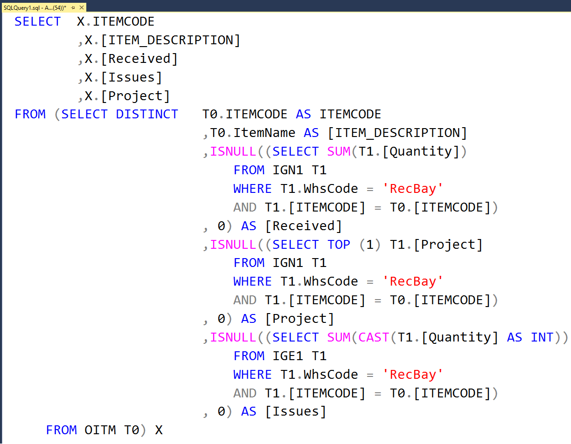
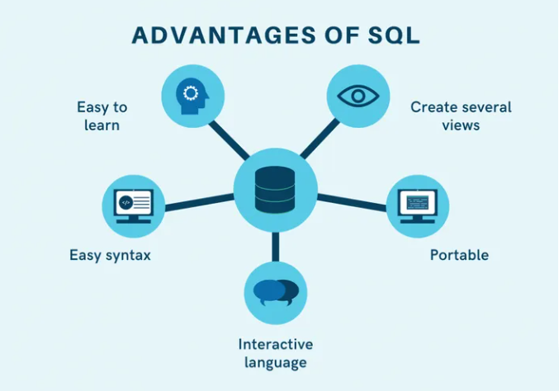
What’s the use of it?
Important for data science
Ease of learn
SQL is used to communicate with a database

Slide 5
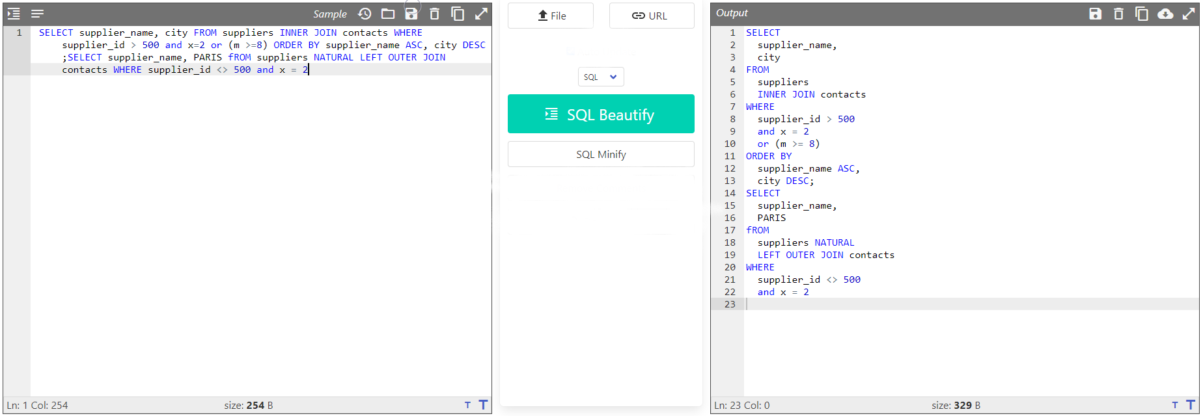
What is a SQL Formatter?
SQL Formatter helps to format SQL code, and it makes it more readable.
It is a utility that converts the unreadable SQL code into a readable format
It’s like Json Formatter or Pretty Printer.

Slide 6
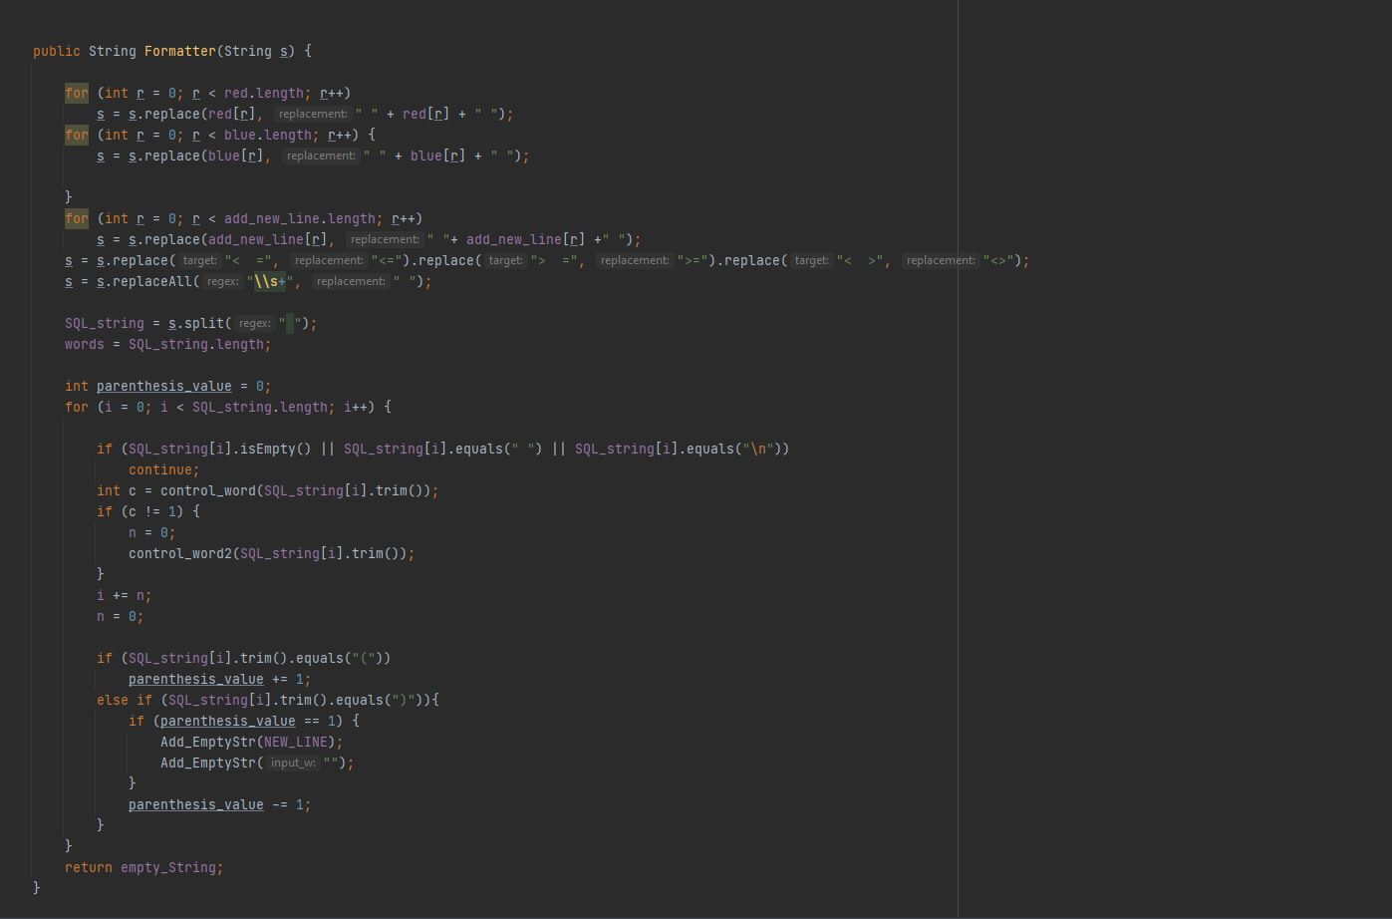
Implementation of SQL Formatter
In more classic ways

Slide 7
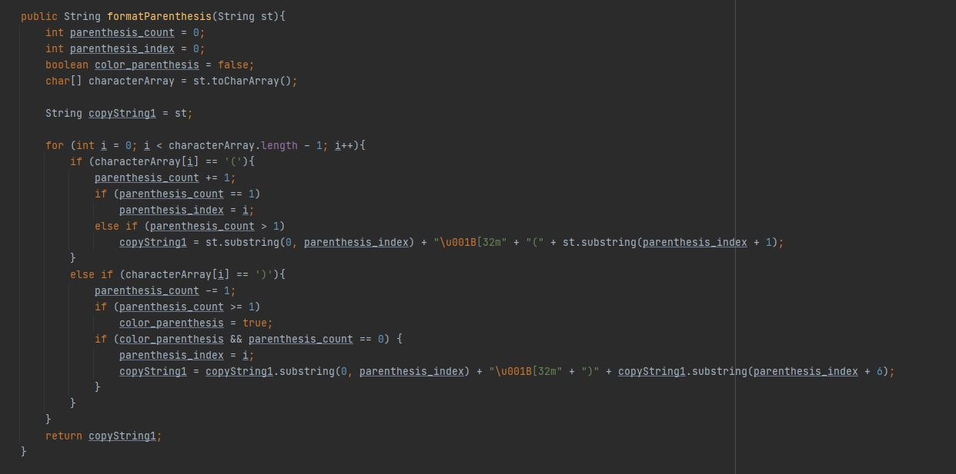

Slide 8
DEMO

Slide 9
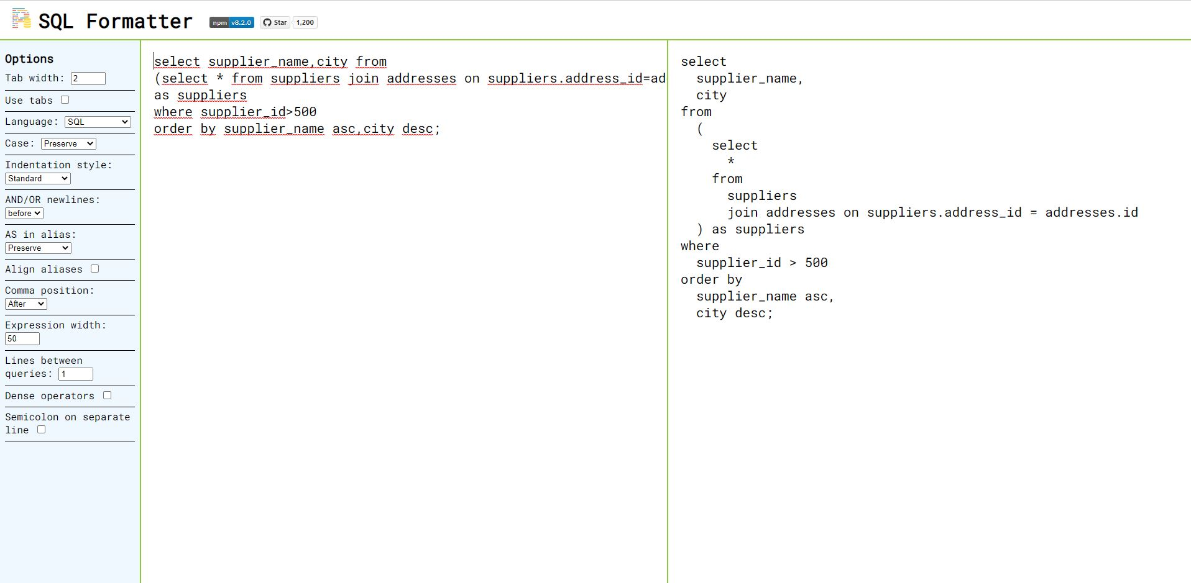
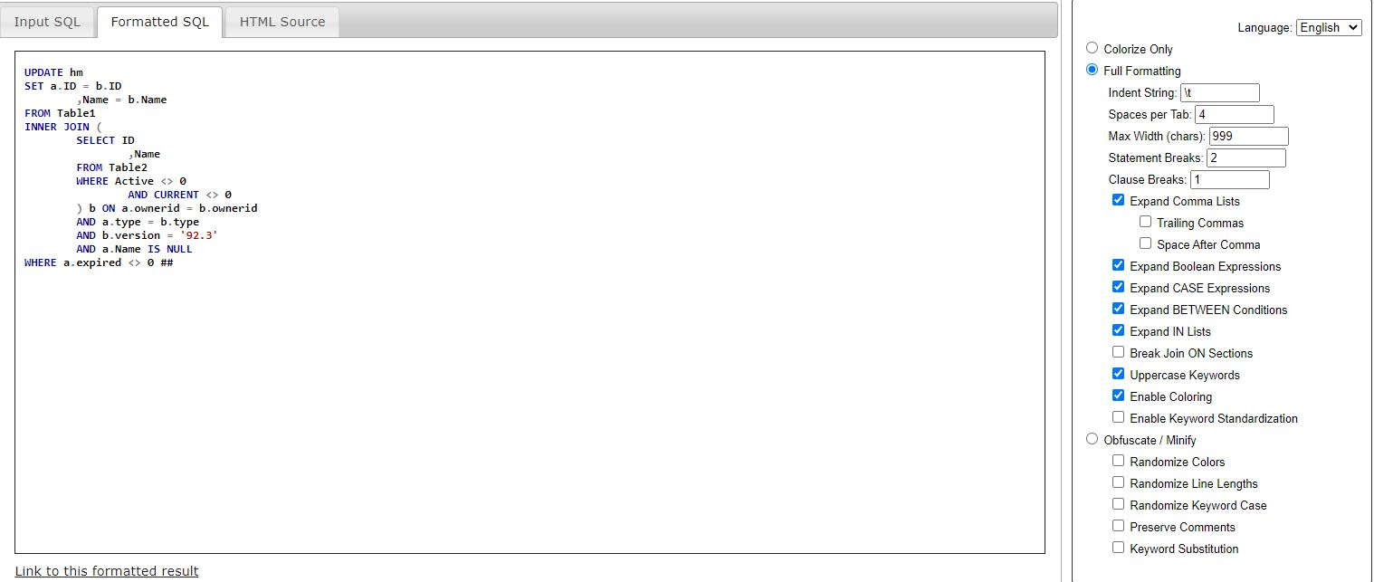
Extras
Web Application
https://github.com/sql-formatter-org/sql-formatter
https://github.com/TaoK/PoorMansTSqlFormatter

Slide 10
Thanks for listening

